Slide 1
Study case: Biomanufacturing workflows
BioHackathon26 DBTLHub Project

Slide 2
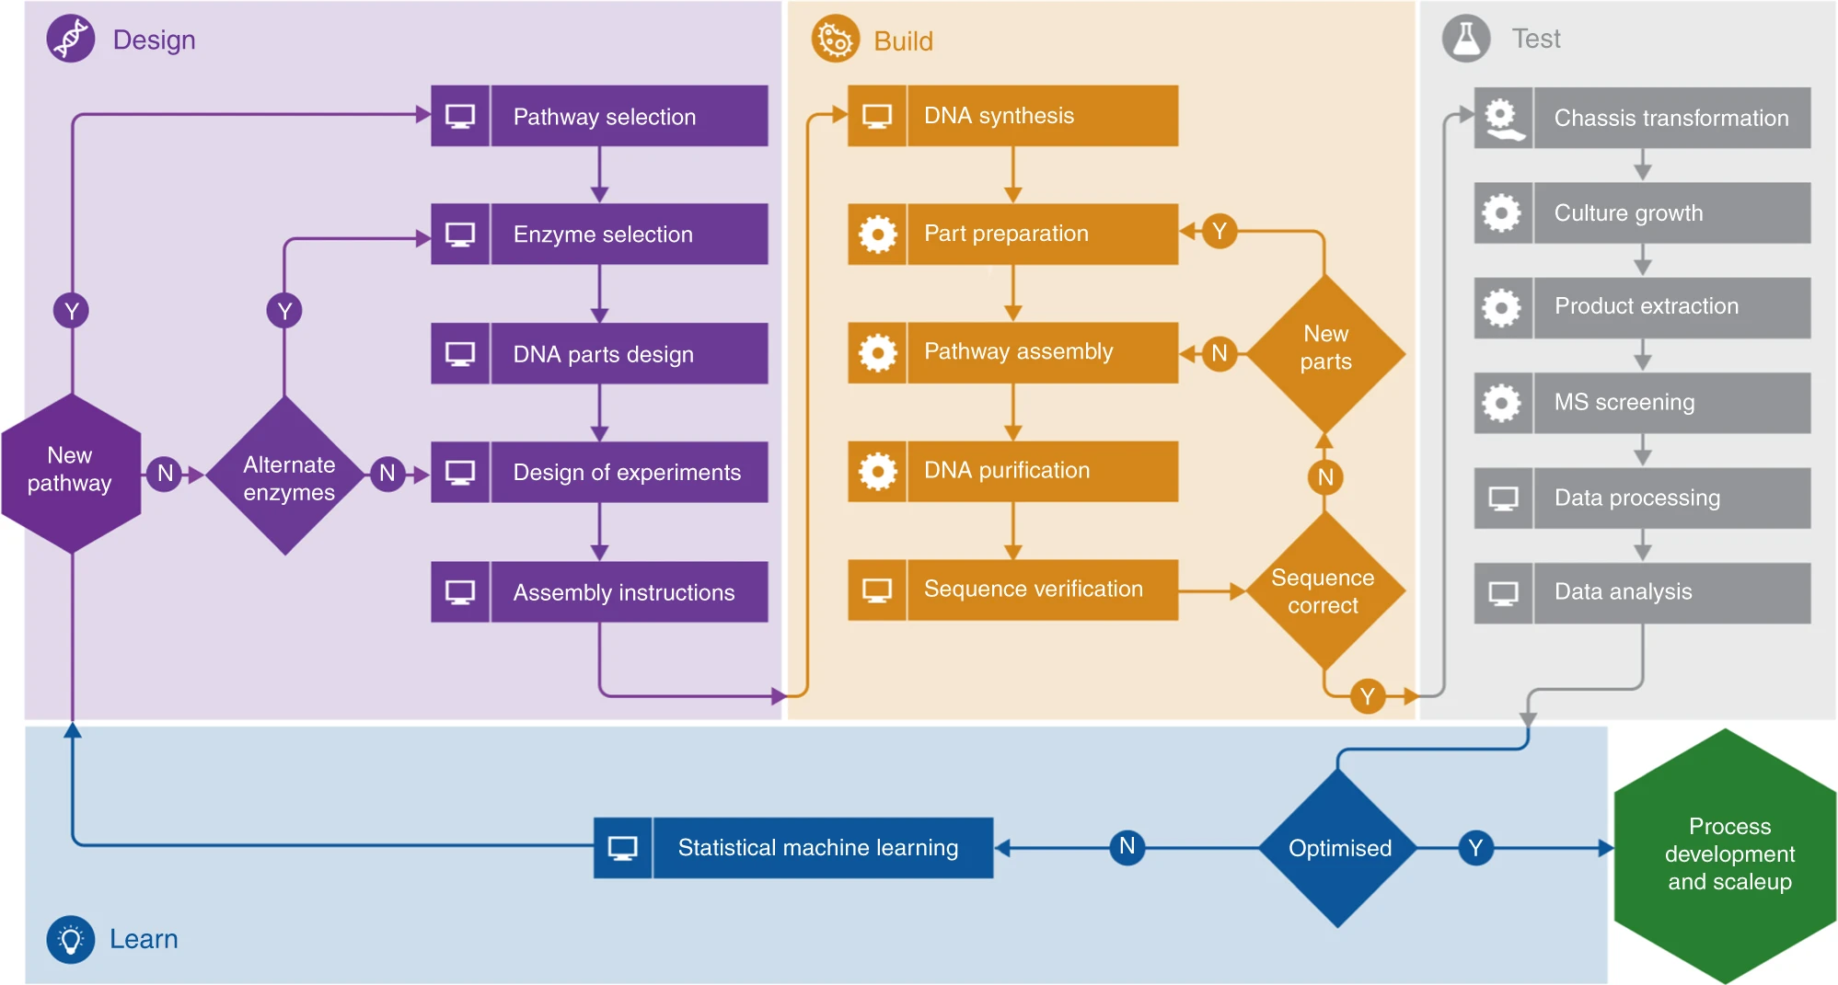

Package manager
(pypi, conda)

Slide 3
Bioprocess design
Strain design
Design
Decision support**
Pathway
Ranking
Enzyme Optimisation
Enzyme
DNA parts
*Design of Experiments
Statistical/optimal
Model-based
Other factors (env.,)
**Decision support Modeling tools
Constrained-based
Kinetic
Hybrid models
Predictive ML
Generative AI
Issues:
Findable code
Tools non-usable without modification
Requirements of external databases (reaction rules, genes, genetic parts) would be nice to allow user-selection
Common input-output to allow swappable code
DoE*
Input
Output

Slide 4
Strain design
Study case 3: Directed evolution workflow
Design
Decision support**
Bioprocess context
Equipment
Objectives:
Titer, Rate, Yield
Constraints
Budget
…
Pathway RetroPath
Ranking
RO-Crate
Enzyme Optimisation
Enzyme
Selenzyme
AI AGENTS
RO-Crate
DNA parts
RO-Crate?
*Design of Experiments
Statistical/optimal
Model-based
Other factors (env.,)
**Decision support Modeling tools
Constrained-based
Kinetic
Hybrid models
Predictive ML
Generative AI
RO-Crate
DoE
OptBioDes (Galaxy SynBioCAD)
Input
Output
Notes:
Ranking made by Agent / Formula

Slide 5
Agent-based Design-Build Interface
BUILD
Input
DESIGN
Output
Design: list of sequences
RO-Crate provenance info
Context info
Synthesis
Protocol

Slide 6
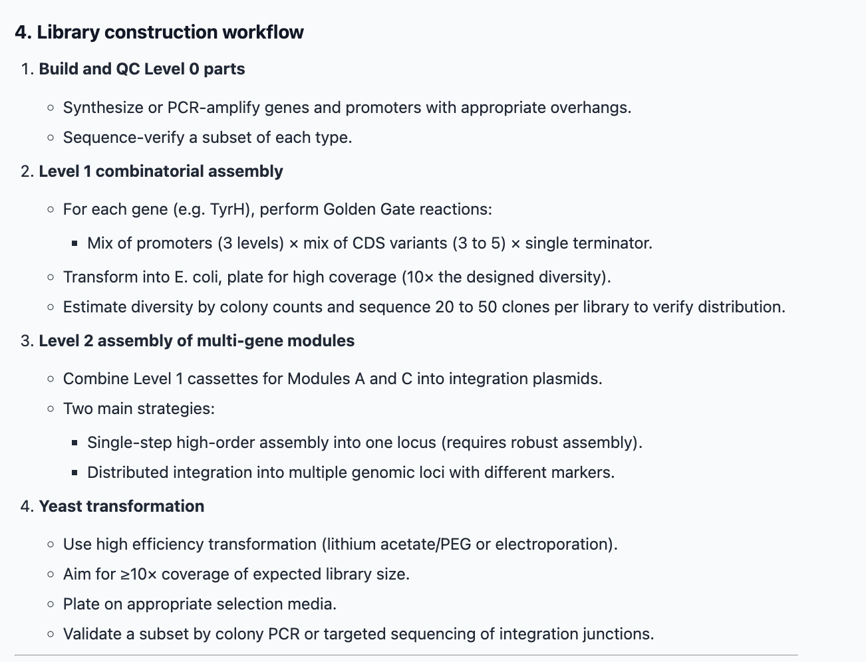
Agent-based Design-Build Interface
TOOLS
How to:
Experimental planning
Synthesize the DNA parts
Assembly the pathways
  which protocol
  which equipments
BUILD
Input
DESIGN
Output
List of sequences
AGENT
RO-Crate provenance info
Context info
WORKFLOW
PROMPT

Slide 7
Build
Assembly protocol
Tool: DNABot,
DNA synthesis
Pathway assembly
Sequence verification

Slide 8
Test
Continuous (online, realtime data)
Discrete (samples)
Culture growth and extraction
E.g., Omics
Data analysis
Data analysis
*Could swap these around
Cell-free
Data integration (cleaning, combining, etc.)
Biosensor design
Screening
Pathway regulation

Slide 9
Learn
Which questions*
Training
Validation
*Questions:
How to improve TRY
What are the next experiments?
Which pathways should be built?
Chassis optimisation / suitability
Scaling-up
Check if models should be re-parameterised
Decision support: Which changes in the experimental protocol?
Predictions

